Slide 1
Role of AI in Health Care

Slide 2
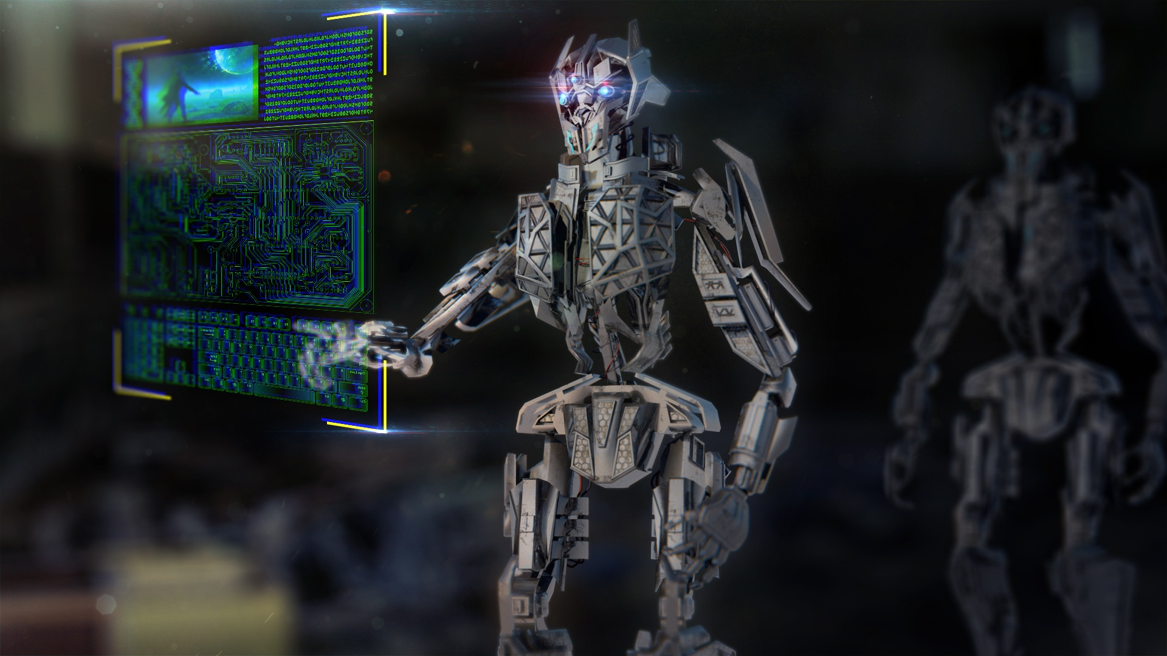


Slide 3
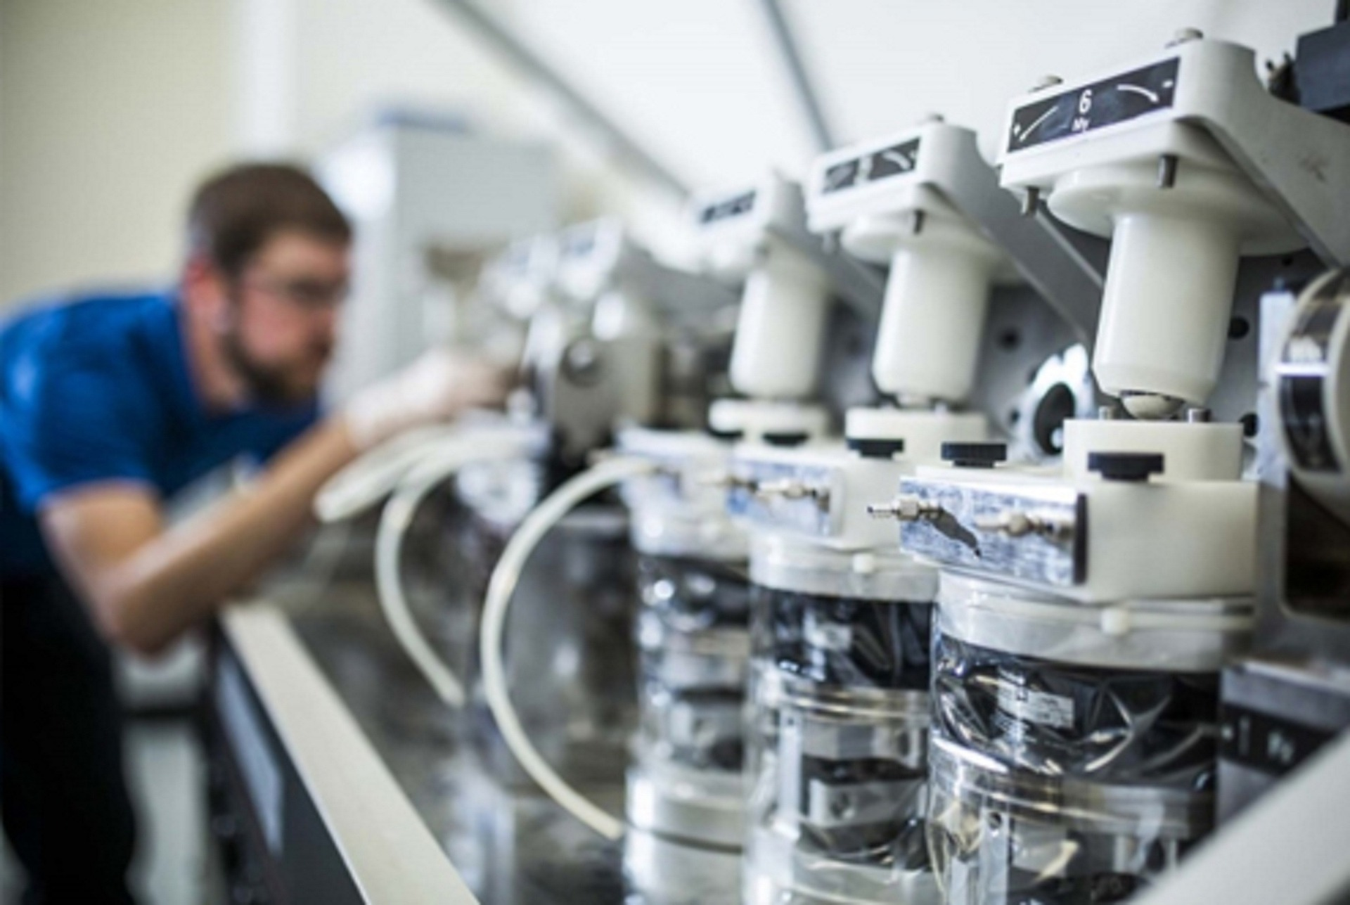

Slide 4


Slide 5
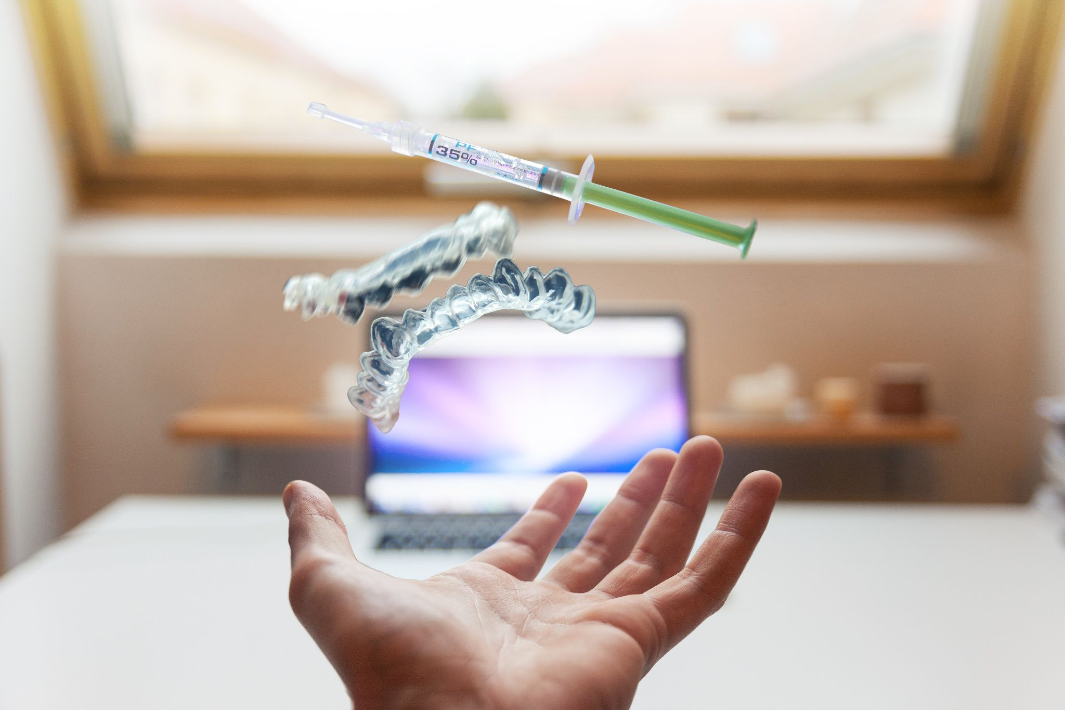

Slide 6
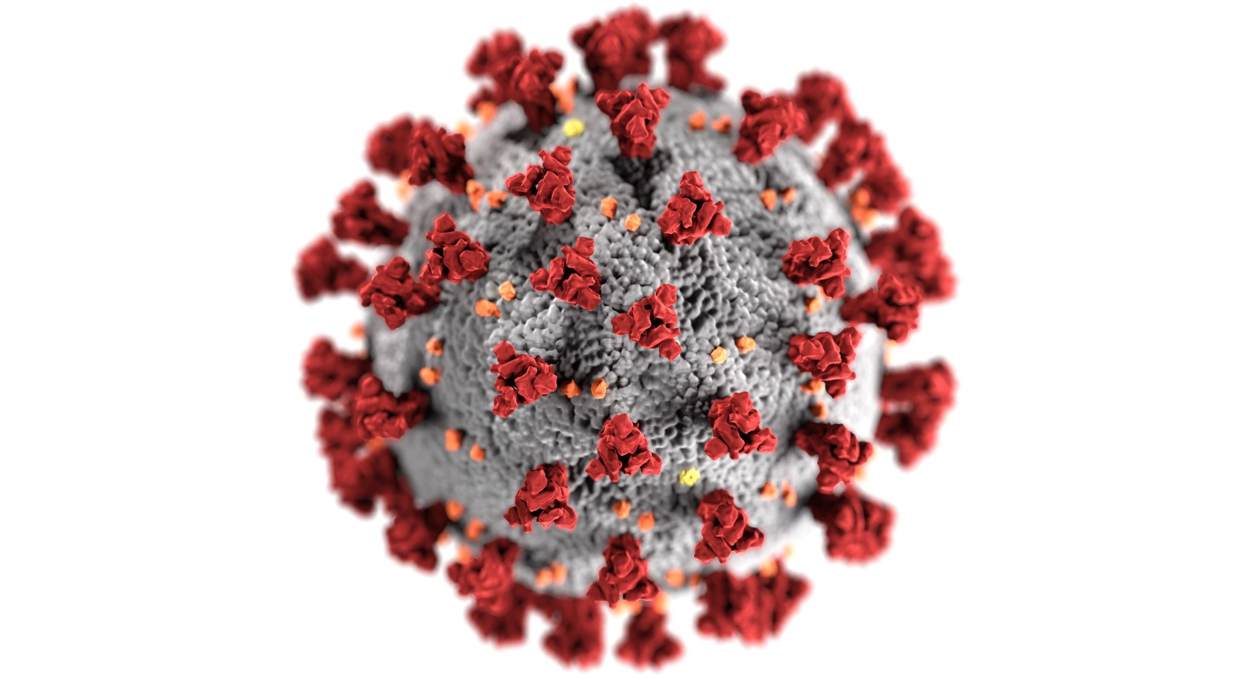

Slide 7
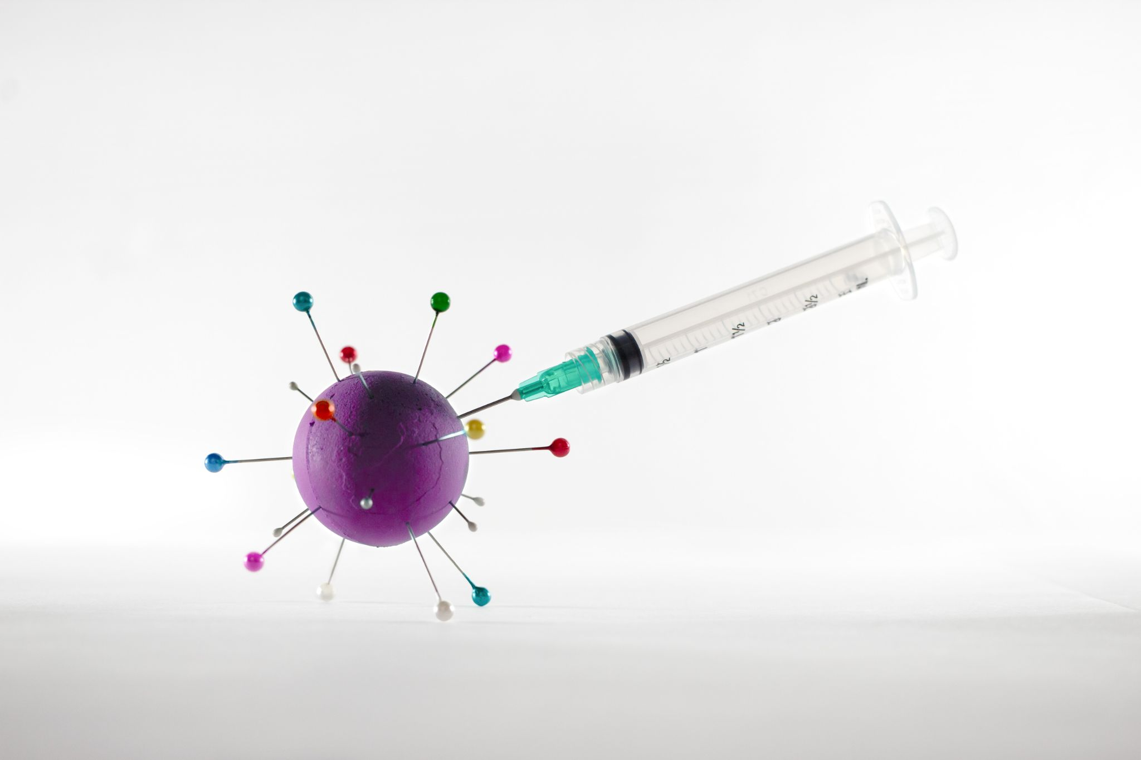

Slide 8


Slide 9


Slide 10


Slide 11
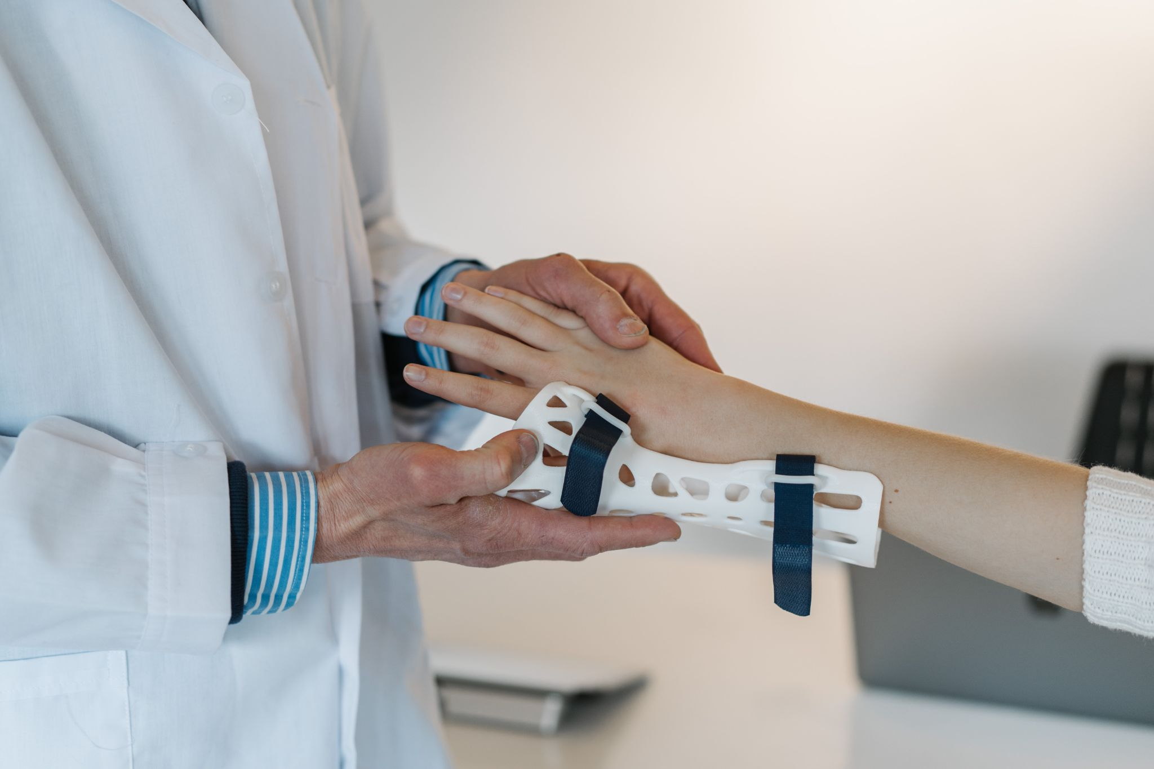

Slide 12


Slide 13
Heart Disease Algo Flow
K-NEIGHBOURS CLASSIFIER
RESULT
TEST DATA
DATA
DECISION TREE CLASSIFIER
RESULT
TRAIN DATA
RANDOM FOREST CLASSIFIER
RESULT

